Slide 1

MS-Copilot Agent creation

Slide 2
Benefits Using Agents
Agents follow predefined prompts and rules, ensuring:
Uniform test case formats
Standard naming conventions
Consistent coverage across projects
Agents can use:
Past test cases
Requirement documents
Organizational standards

Slide 3
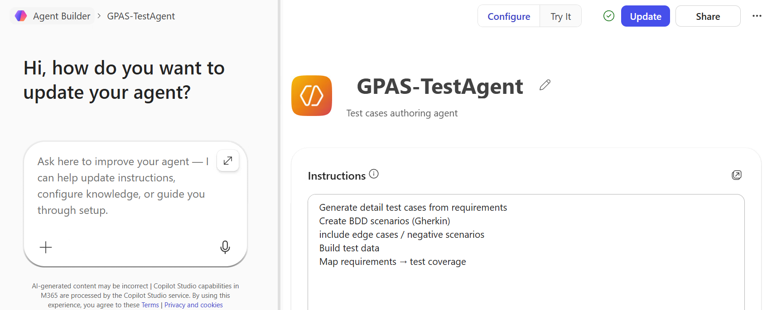
Creation/Configure Agent
Steps to follow:
Go to Copilot Studio
Click Create → New Copilot
Provide:
Name: GPAS - TestAgent
Description: “Test case authoring agent”

Slide 4
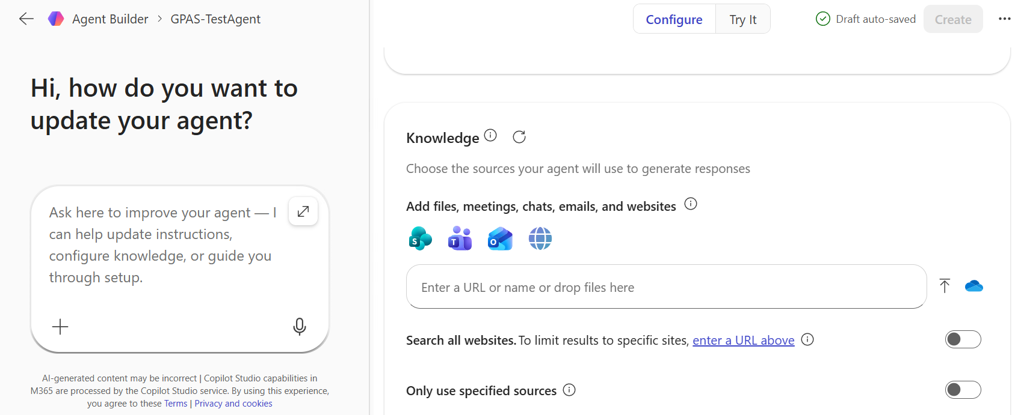
Steps to follow:
Provide all knowledge sources to copilot can refer
Example – User story links, associated business rule documents, FLS, AP sheet

Slide 5
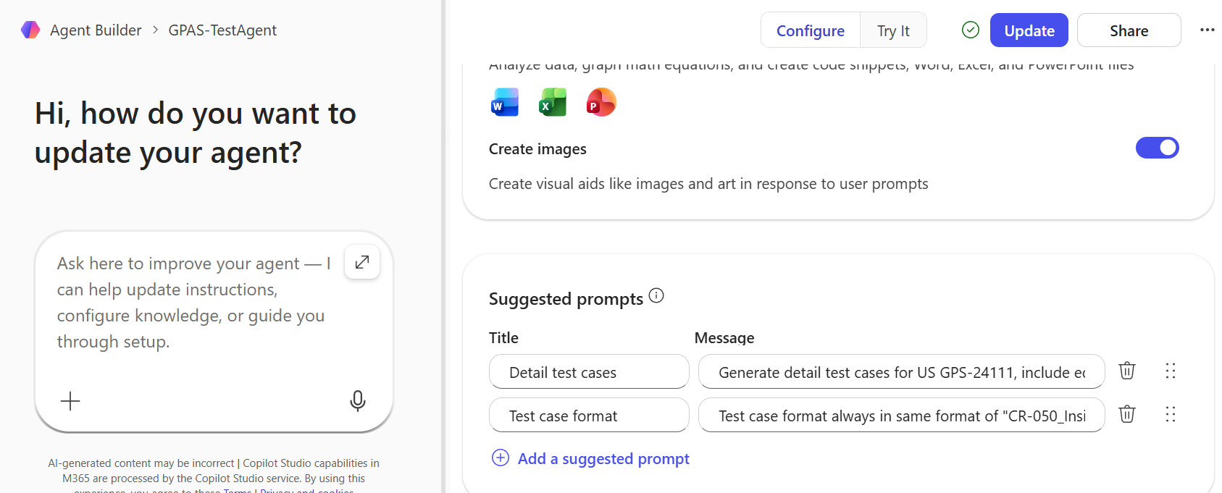
Steps to follow:
Provide the specific prompts, which are standard
Example – test case template format

Slide 6
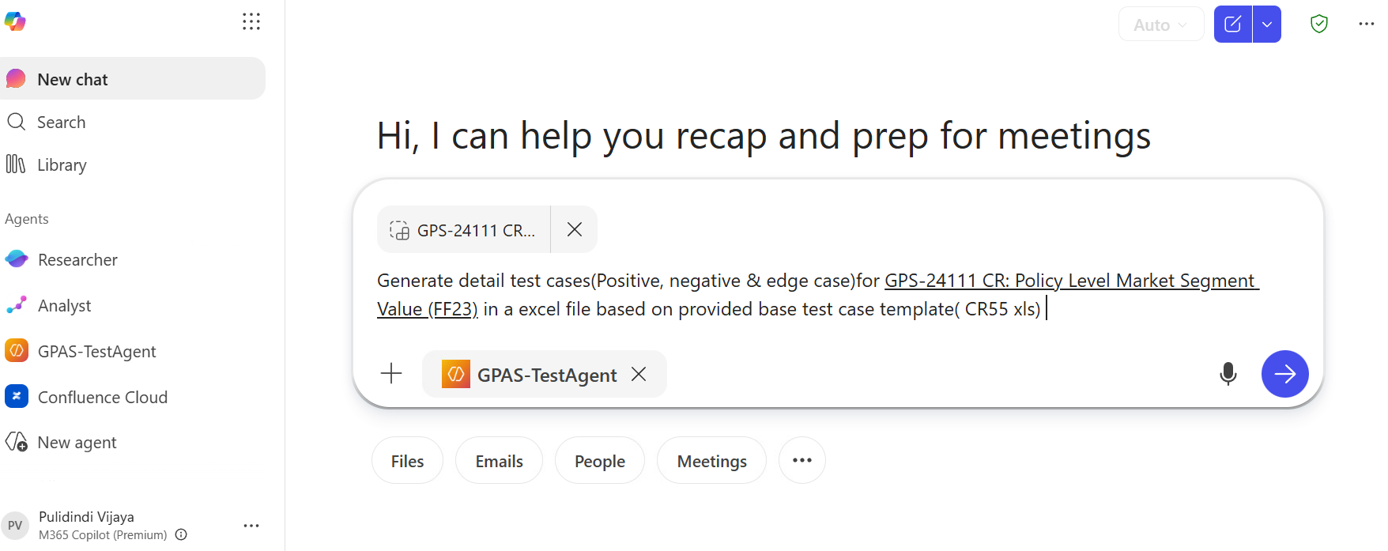
Precise Prompt:

Slide 7
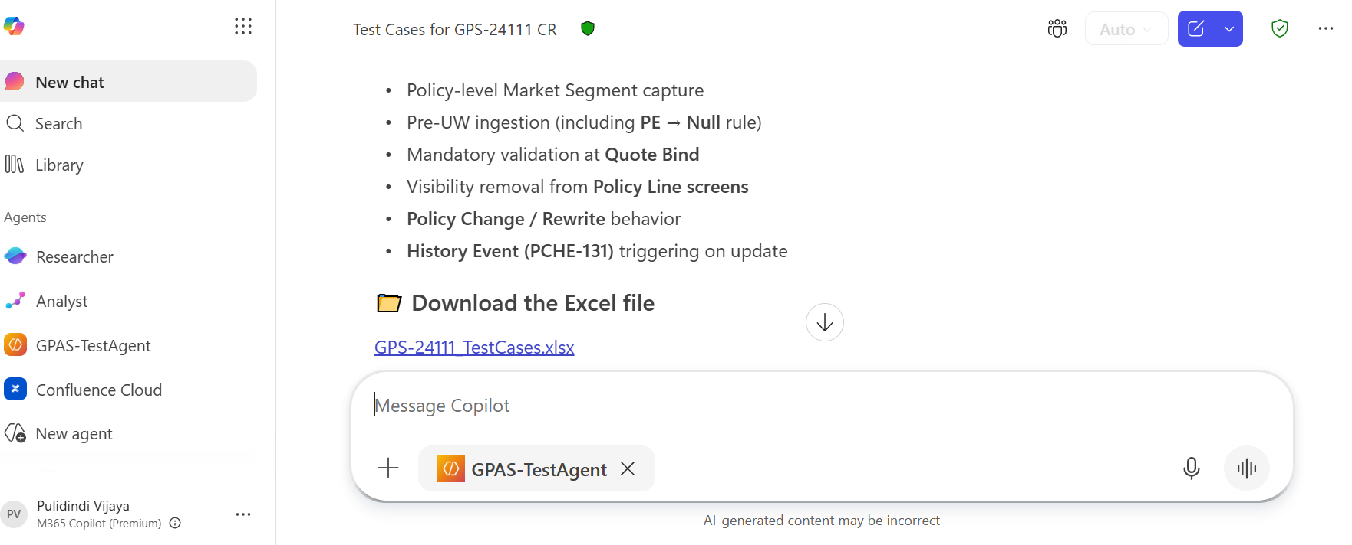
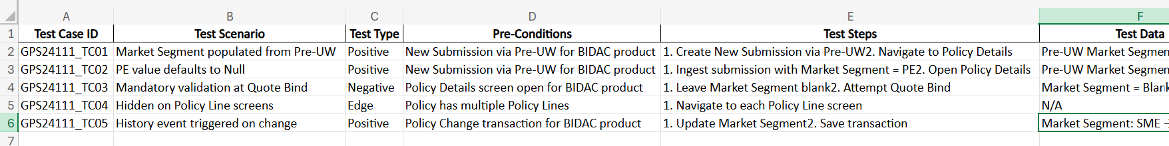
Output from Co-pilot

Slide 8

Thank you.
Impact slides
These slide designs and messages are inspirational only. Please modify text boxes and positioning as needed based on the message and overall composition. Always consider the legibility and contrast of copy and content for maximum usability.
Any and all photography in these designs is given as an example. While you can use them, it’s better to change the photography to match your content.
To do so, right click on the picture or placeholder to change/insert a photo.
Where to find photography:
Photo library
Getty images (Recommended), Shutterstock, Adobe images (check with your M&C design team):
Further examples and inspiration are available in Extras file in your Powerpoint
-> File -> New from template…
Make it real.

